Slide 1
Centre for Learning & Empowerment (CLE Trust) An introduction to our mission, teams, programs, approach
August 2025
www.cletrust.org

Slide 2
Content
Mission, teams, partnerships, programs
Pedagogy and approach
Pictures and clips from educational programs
CLE team
How you can be part of our mission

Slide 3
Mission, Teams, Partnerships, Programs

Slide 4
Vision and Mission
Have lots of children from disadvantaged backgrounds access quality education, develop interest in learning, gain confidence, prolong their years of education, and thereby find better opportunities.

Slide 5
How we do it
We conduct educational programs for empowering ..
children and youth from marginalized backgrounds
teachers / facilitators
with a focus on ..
Creative-critical-compassionate pedagogy

Slide 6
Teams, partnerships
children, youth (learners)
schools, teachers, NGOs, govts
CLE teachers (facilitators)
Managing team and trustees
CLE learning centres

Slide 7
Programs
Learning centres
Library, STEM lab, in-person classes, online classes (English, math, science, digital literacy, skills)
8 centres in Jharkhand, 1 in Chennai, 1 coming up in Bangalore
450 students, 10 centre facilitators, 18 online teachers
Online and in-person classes in partnership with local schools and NGOs
Subjects (English, math, science)
Empowering young minds (digital literacy, financial literacy, health, socio-economic issues)
Undergraduate admissions
16 locations across 6 states in India
580 students, 26 online teachers, 3 in-person teachers
Teacher empowerment
Workshops on creative, learner-centric teaching methods
4 locations in Tamil Nadu and Karnataka
200 school-teachers, 8 trainer-mentors

Slide 8
Pedagogy and Approach
happy classrooms
creative-critical-compassionate pedagogy

Slide 9
Three elements
happy classroom
TEACHING
TAUGHT
TEACHER
Education happens when these three elements combine into one whole
A teacher who is knowledgeable, sincere & kind
A subject matter that is interesting
Students who are curious, attentive & learning
We address all three elements –we believe focusing only on the subject matter is incomplete

Slide 10
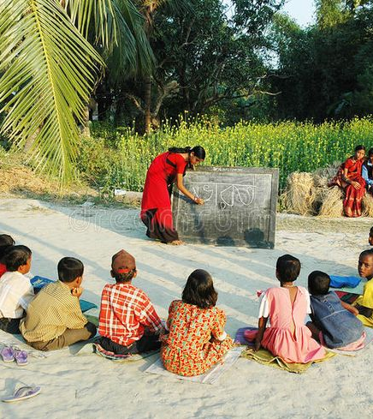
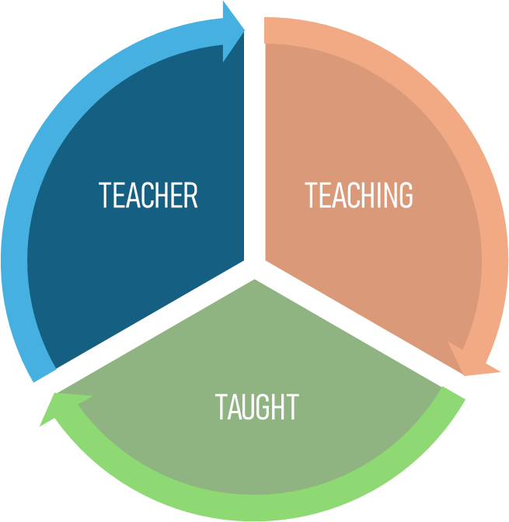
Favorite teacher
happy classroom
Each of us will remember our favorite teacher from school
They did not just teach / cover syllabus / give us knowledge – they did something more
They told stories / they loved us / they believed in us / they were forgiving when we made mistakes / they guided us
They did not hit us / punish us / discipline us – but we did not take advantage of them!
We did not feel any fear - they were one among us & we felt connected

Slide 11
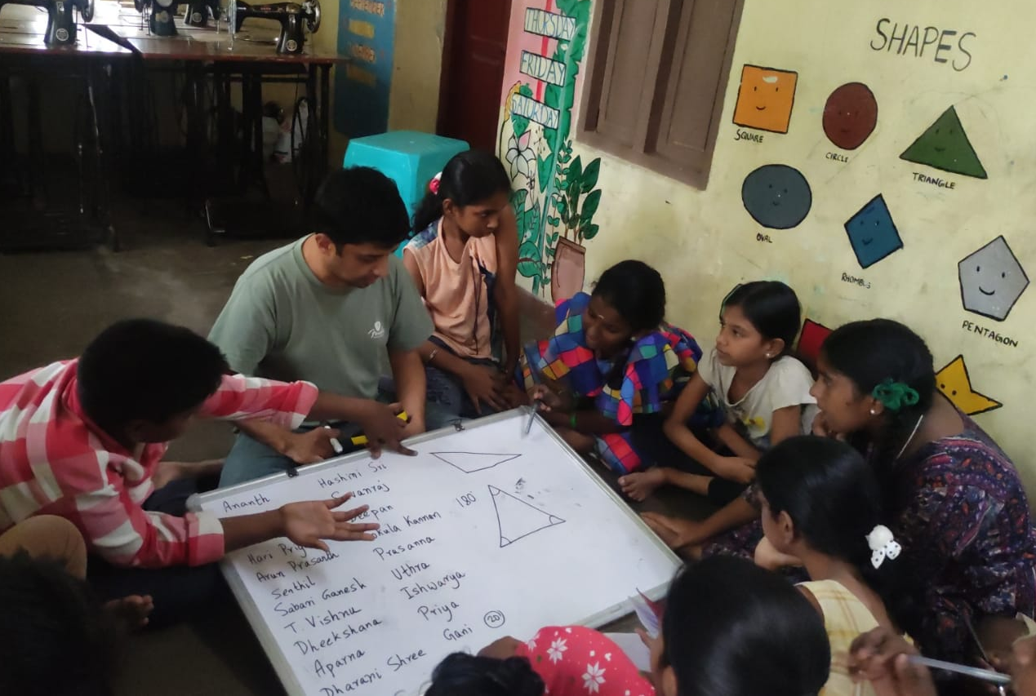
School teacher
happy classroom
Teachers shape future societies – one child at a time
Not any teacher. Teachers with an acute awareness & understanding of their role and ability to perform it
Teacher facilitates this through classroom sessions, conversations, and most importantly practices
Gives teachers a sense of pride combined with a profound responsibility
Makes teaching soulful – for both teachers & students
Class management becomes simpler

Slide 12
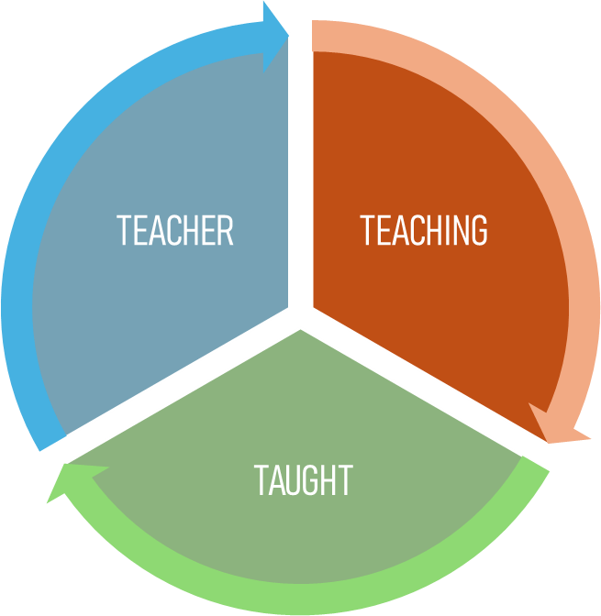
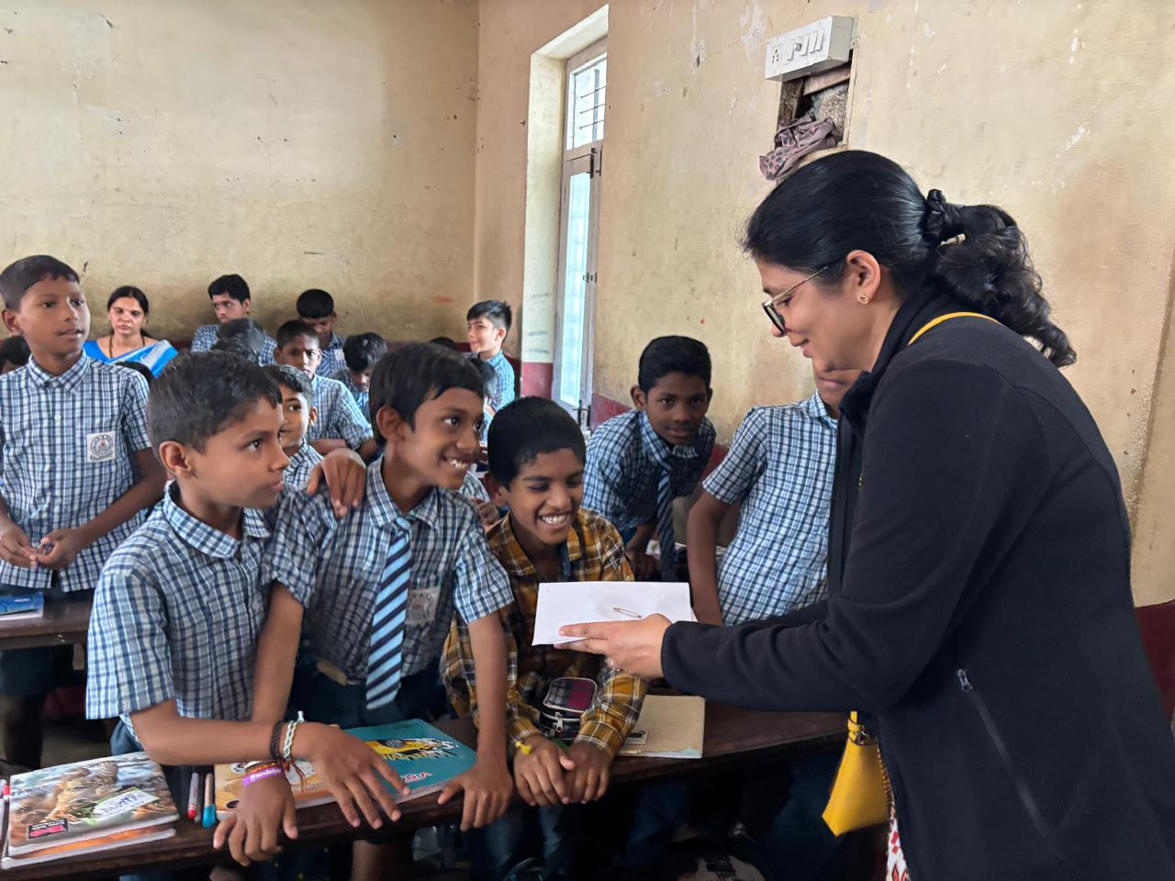
Teaching
happy classroom
Process of discovery
Fun & Practical
Experiments
Puzzles and Games
Exploration and independent thinking

Slide 13
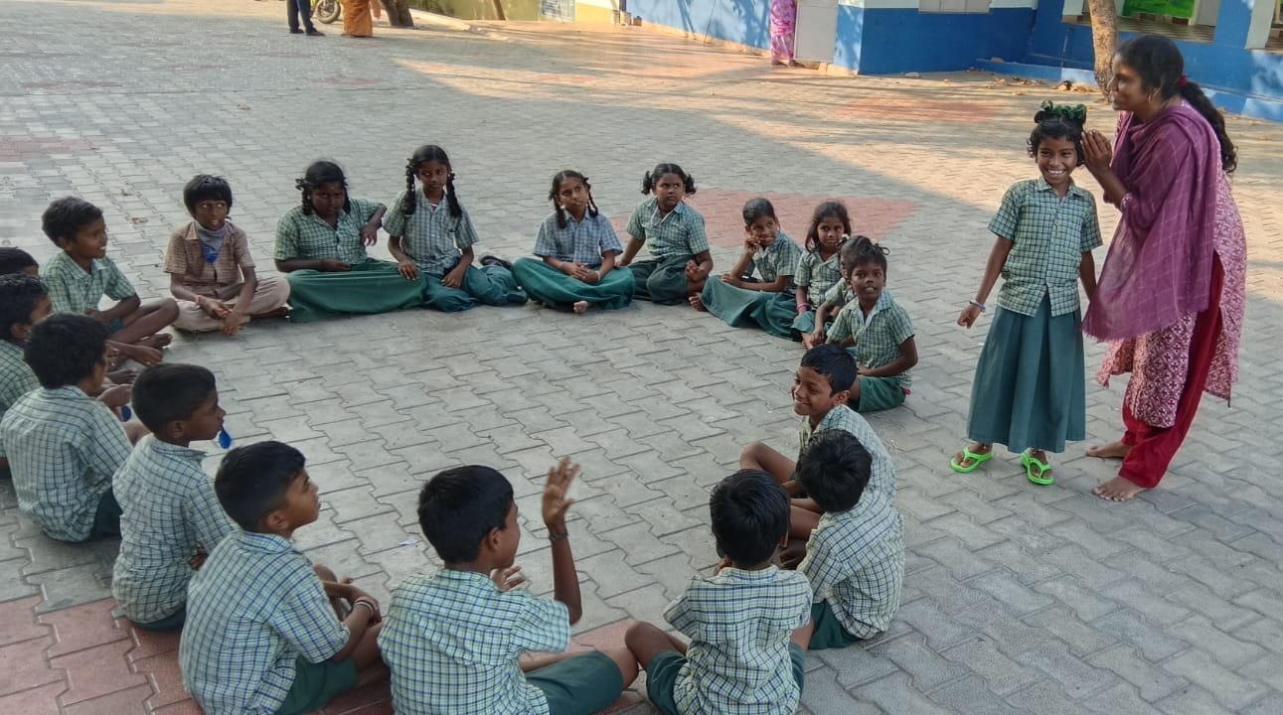
Process of learning
happy classroom
Activities, games, experiments
fun,
teamwork, question, conjecture,
critical thinking, struggle,
discover,
‘wow’ moments
Discover concepts
Formalize concepts
repeated practice,
critical thinking,
struggle,
pattern recognition
Practice
(puzzles, exercises, read, write, solve problems)

Slide 14
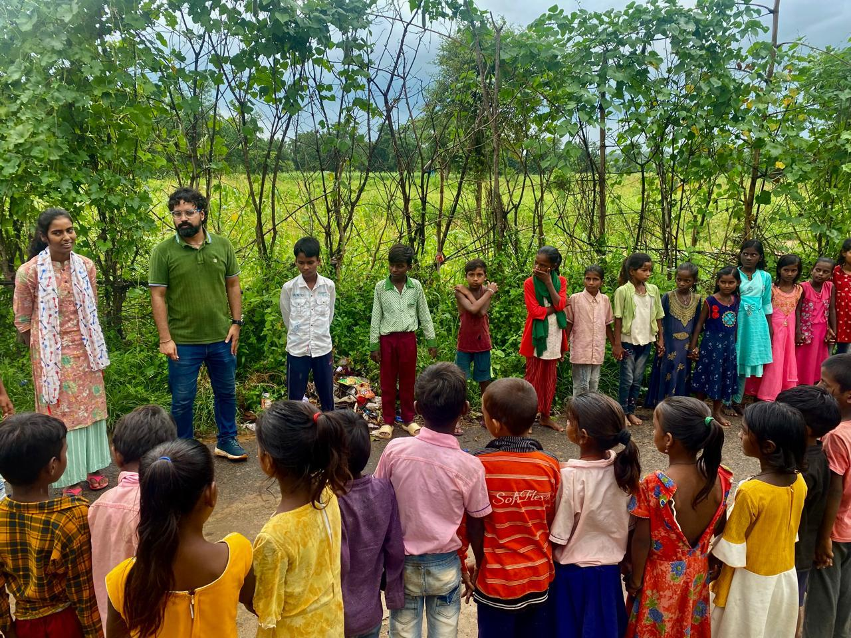
Teaching - Discovery
happy classroom
18 pebbles – two groups
Prime number is discovered
When a class discovers, that knowledge is personal
Ownership is theirs
Not my teacher told me so!

Slide 15
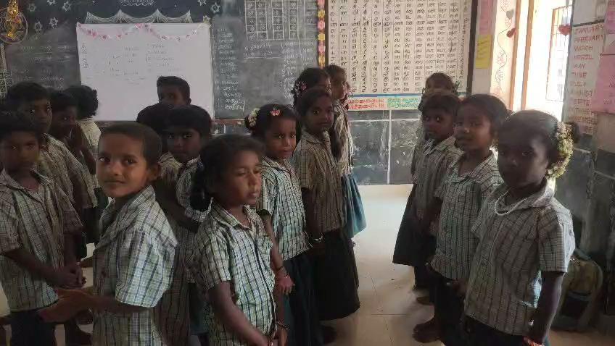
Teaching – Fun & Practical
happy classroom
Ratio homework
Find ratios of how to make Idli batter, ratio of family income spent on food, education, rent etc.
Keep it real, keep it fun
Video

Slide 16
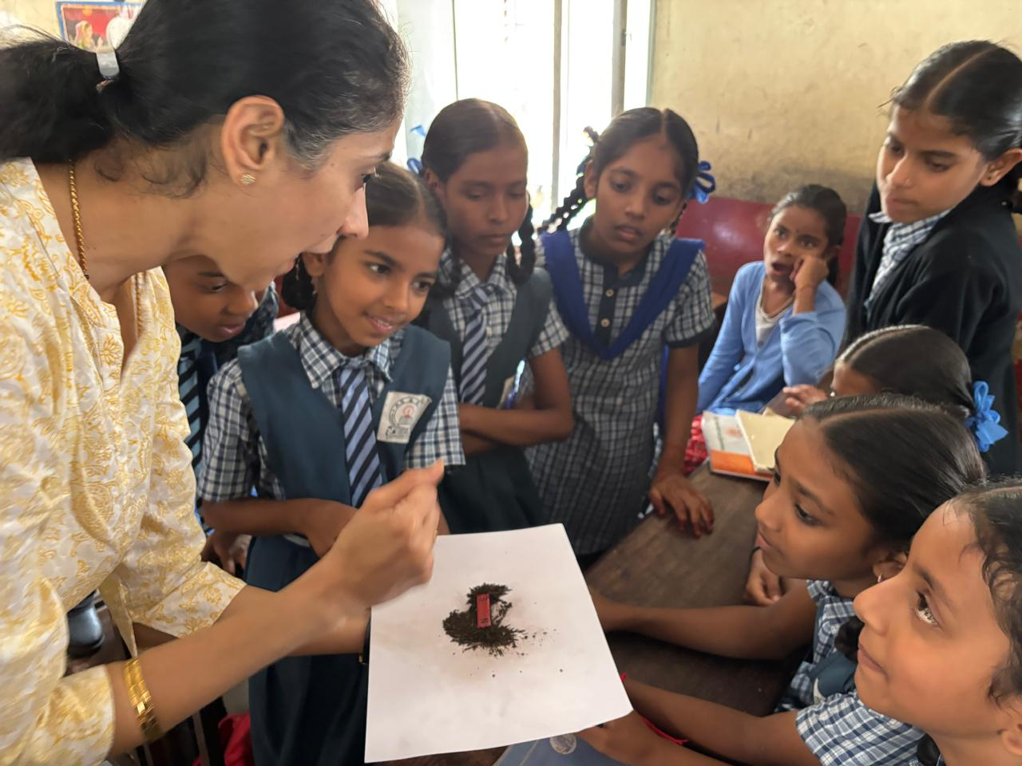
Teaching - Experiment
happy classroom
Experiments integrated with conceptual learning
Developing a mind that can think of an experiment, set it up, find results and draw conclusions
Learning is almost automatic & permanent

Slide 17
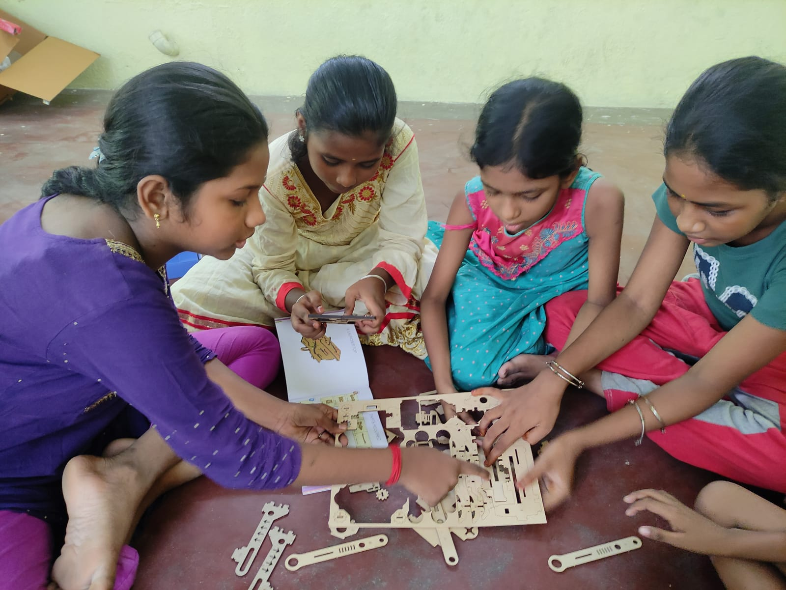
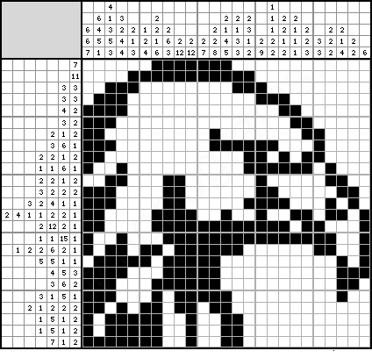
Teaching – Puzzles+Games
happy classroom
Improves critical thinking, problem solving, pattern recognition and computation skills

Slide 18
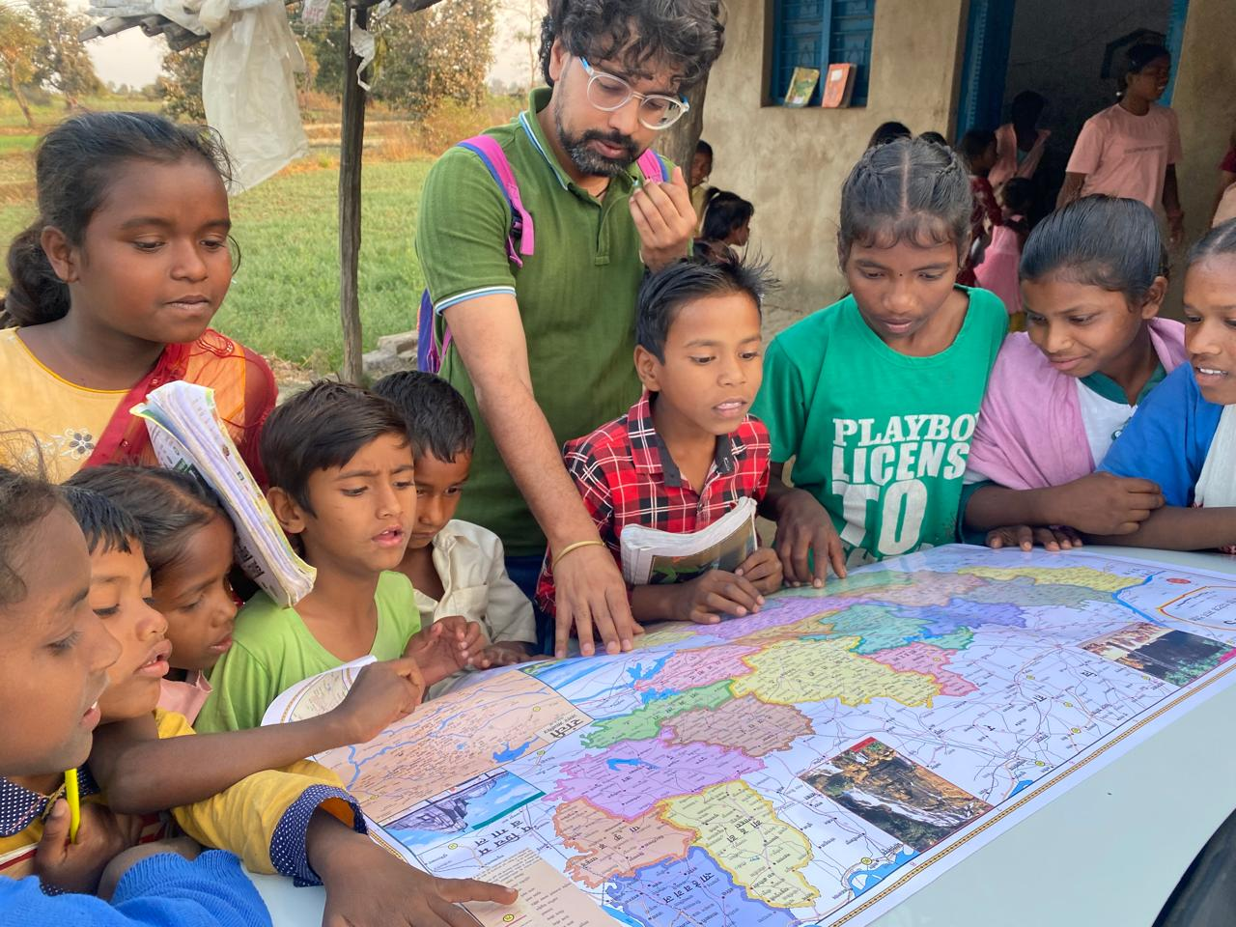
Teaching - Exploration
happy classroom
School data collection
Family & village data collection
Discussions on our society and issues
Explorations on the world around us
Exploring our inner world of thoughts and emotions

Slide 19
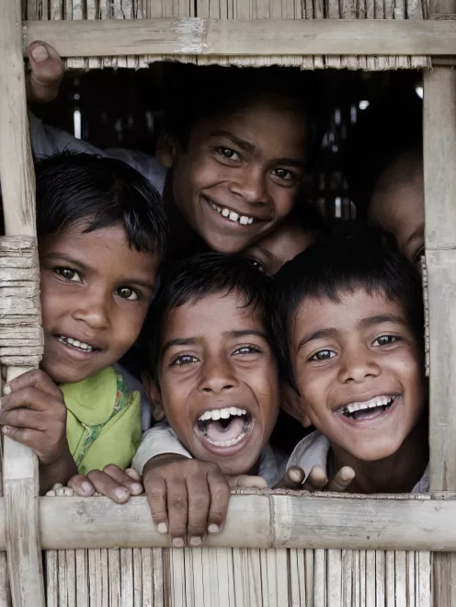
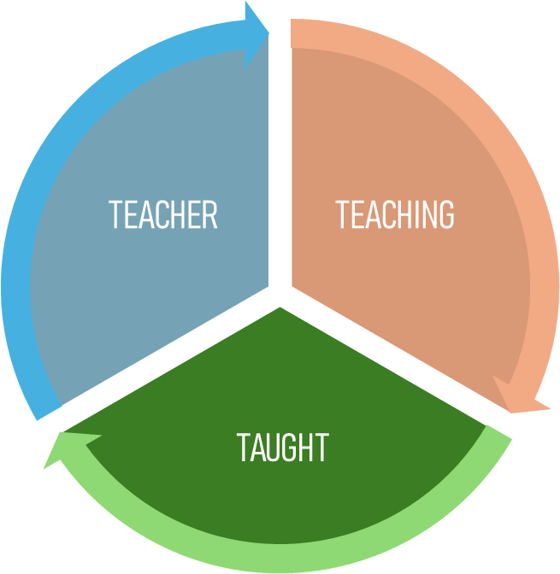
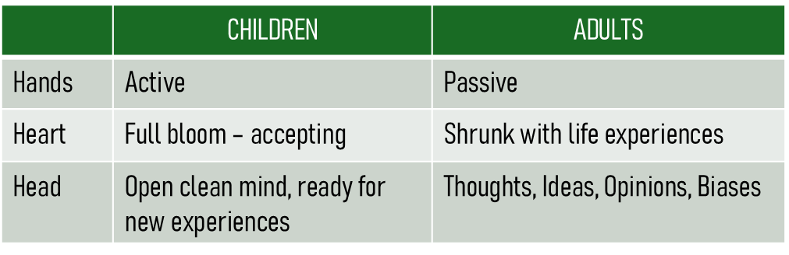

Children
happy classroom
To teach children, we must be like one - shoshin
Active & energetic physical body
Heart that is pure – kind & compassionate
Mind that is open and free of opinions and biases

Slide 20
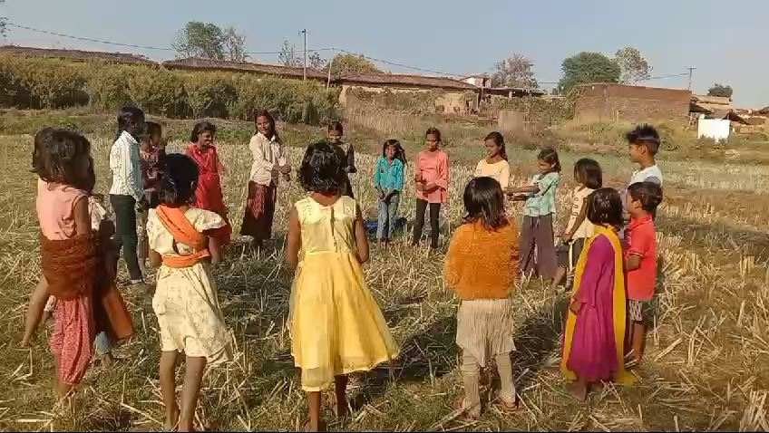
Children
happy classroom
 | CHILDREN | ADULTS
Hands | Active | Passive
Heart | Full bloom – accepting | Shrunk with life experiences
Head | Open clean mind, ready for new experiences | Thoughts, Ideas, Opinions, Biases
Just understanding and internalizing these differences will bring about a change in perception:
They are no longer running in class – their legs are active
They are not lying – their head is trying a new experience
They are not getting influenced – their hearts are naturally accepting of people & ideas
Moving from “don’ts” to “how about this way” – a guide
Video

Slide 21
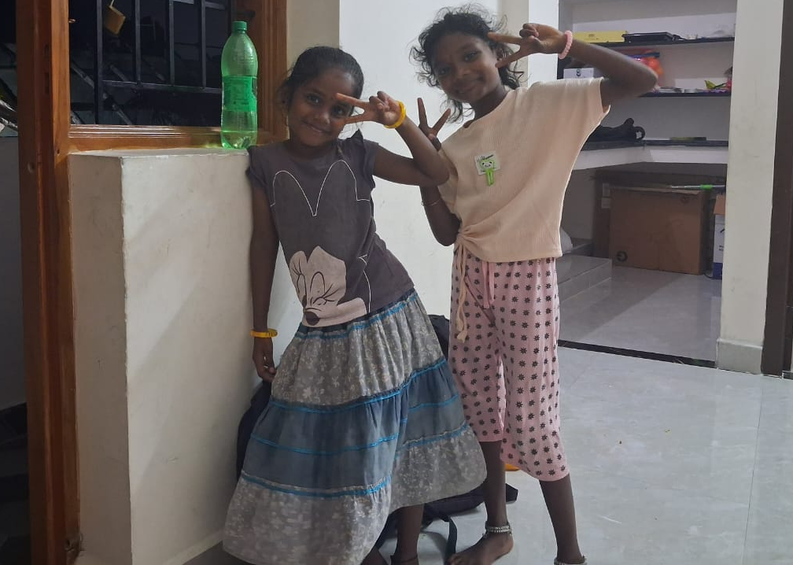
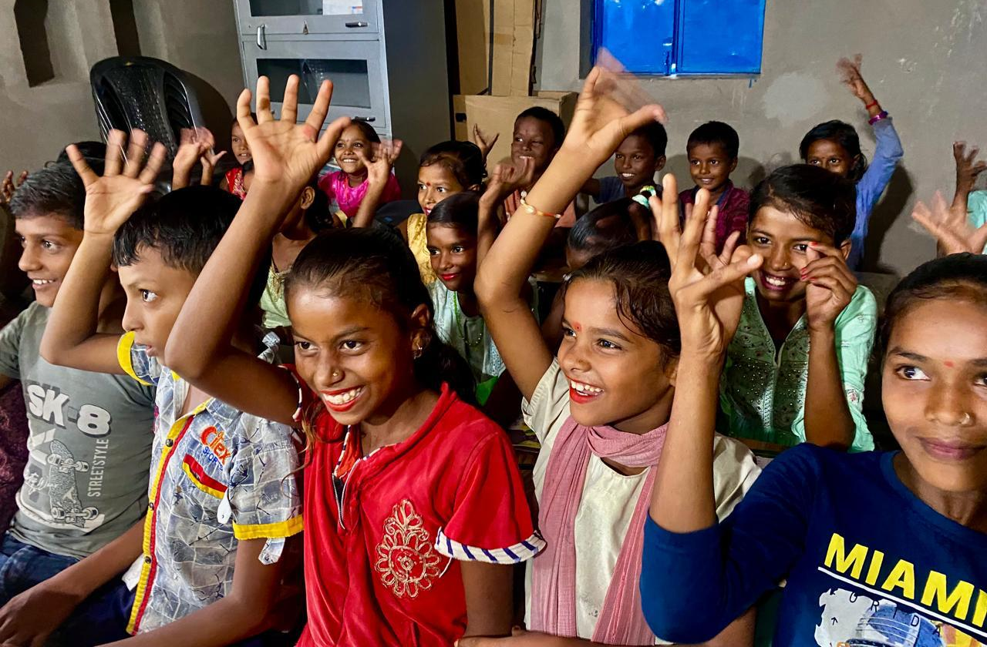
Children
happy classroom
Children come to school to have fun – with friends and in class – learning in the process
If our teaching methods are different from this expectation, it leads to dissonance
The class could lose focus – they came to the wrong movie!
Often, authority and force need to be used
This won’t happen if we widen our perspective

Slide 22
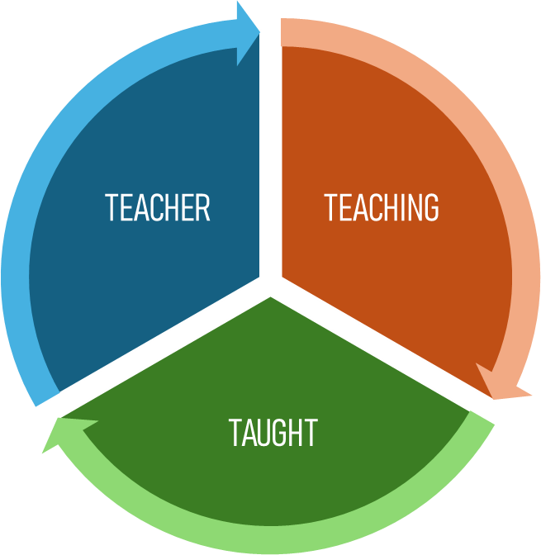
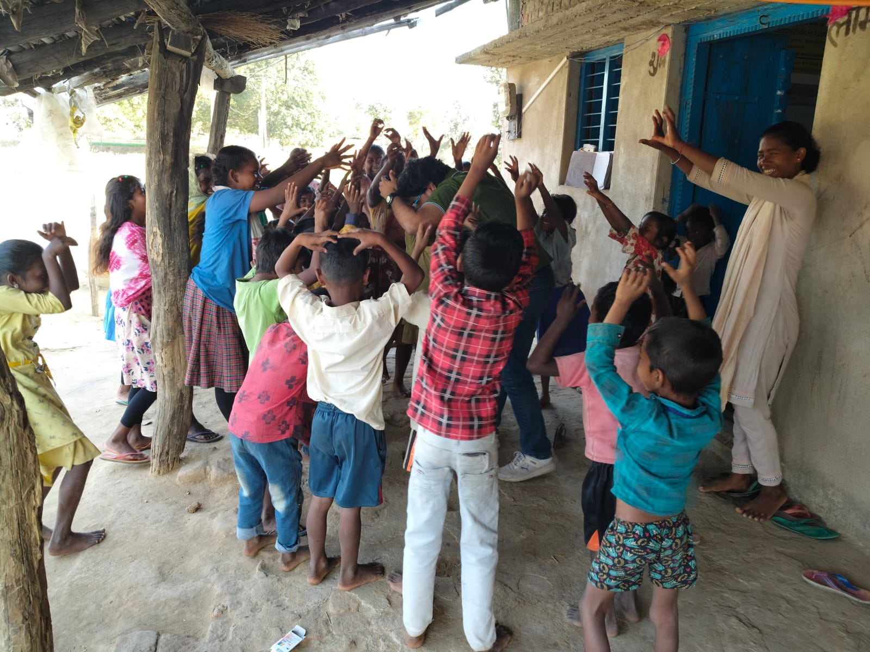
Integration of 3Ts
happy classroom
In such a classroom, learning goes both ways
The teacher, teaching and taught merge into one space of collective learning
Teacher is not a sage on the stage, but a guide on the side
Minimal class management as both sides understand each other
Knowledge embeds deeply; A soulful classroom where education happens!

Slide 23
5 PILLARS OF CLE’s EDUCATIONAL PROGRAMS
ACADEMICS
Good subject knowledge
Children score good marks
Learning is deep and permanent
DISCOVERY
Discovering the world outside
Language, Science, Society, Math
Ability to explore the unknown
TEACHER
No increase in workload
More connected & soulful teaching
More involved and energetic classroom
CLASSROOM
Curious & energetic
Collaborative & compassionate
Self-assured
& Self-aware children
PARENTS
Parents happy with their children
Not just for their knowledge, also as people
INTEGRATION OF ALL THESE GIVES RISE TO A HAPPY CLASSROOM

Slide 24
Pictures and Clips
from various educational programs

Slide 25
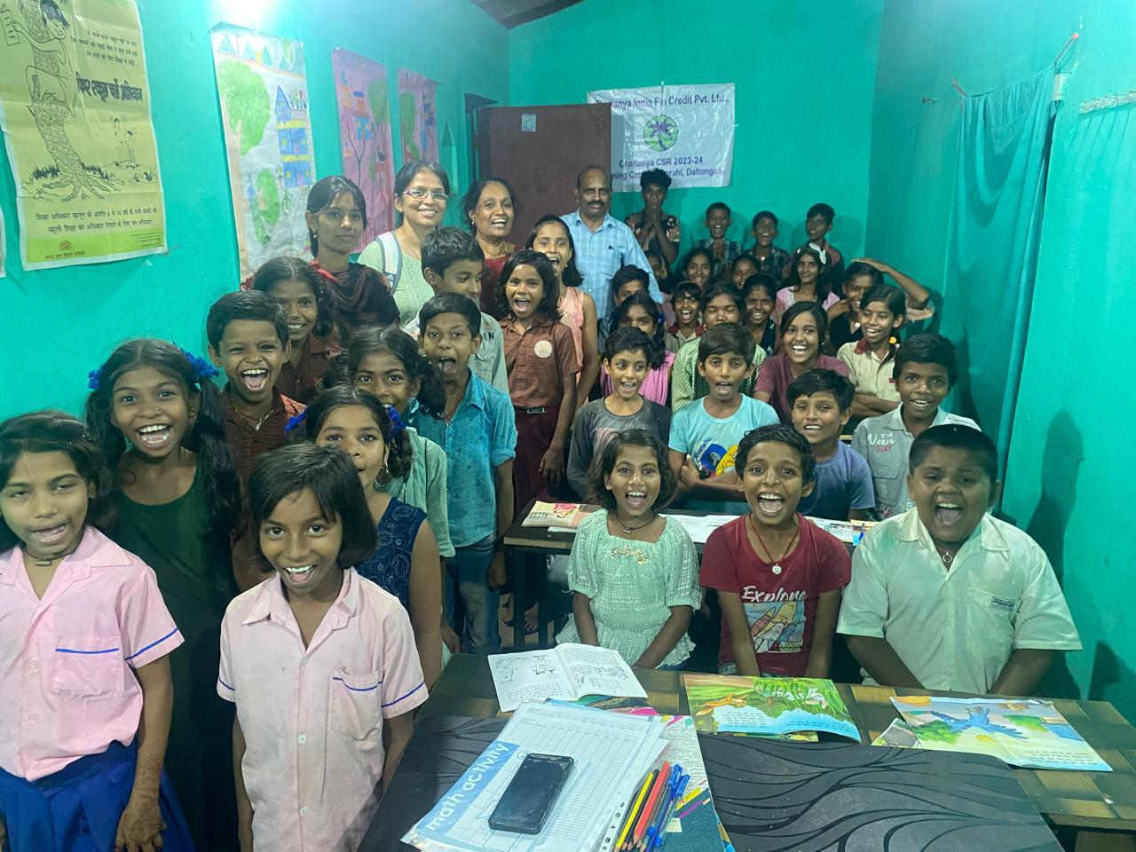
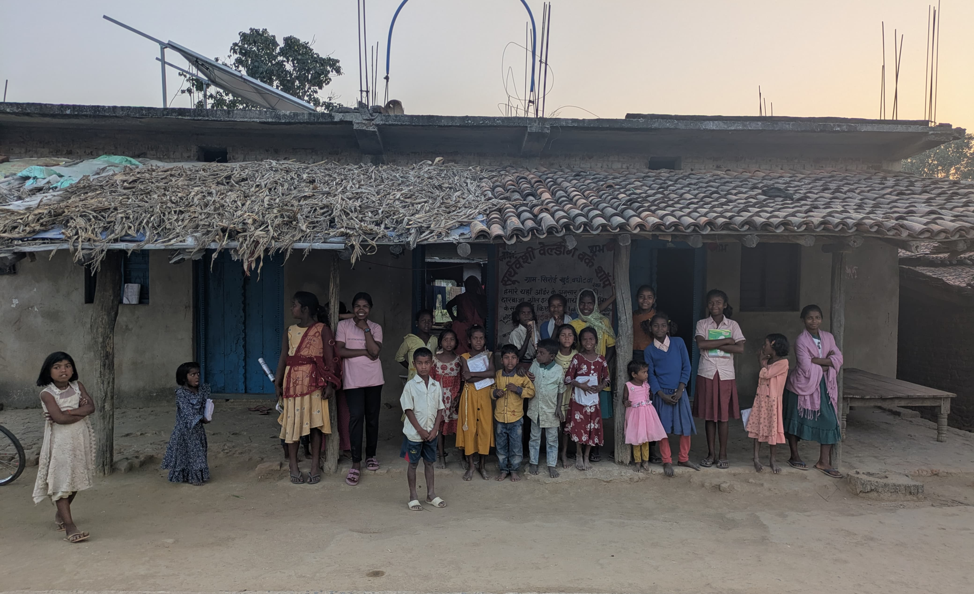
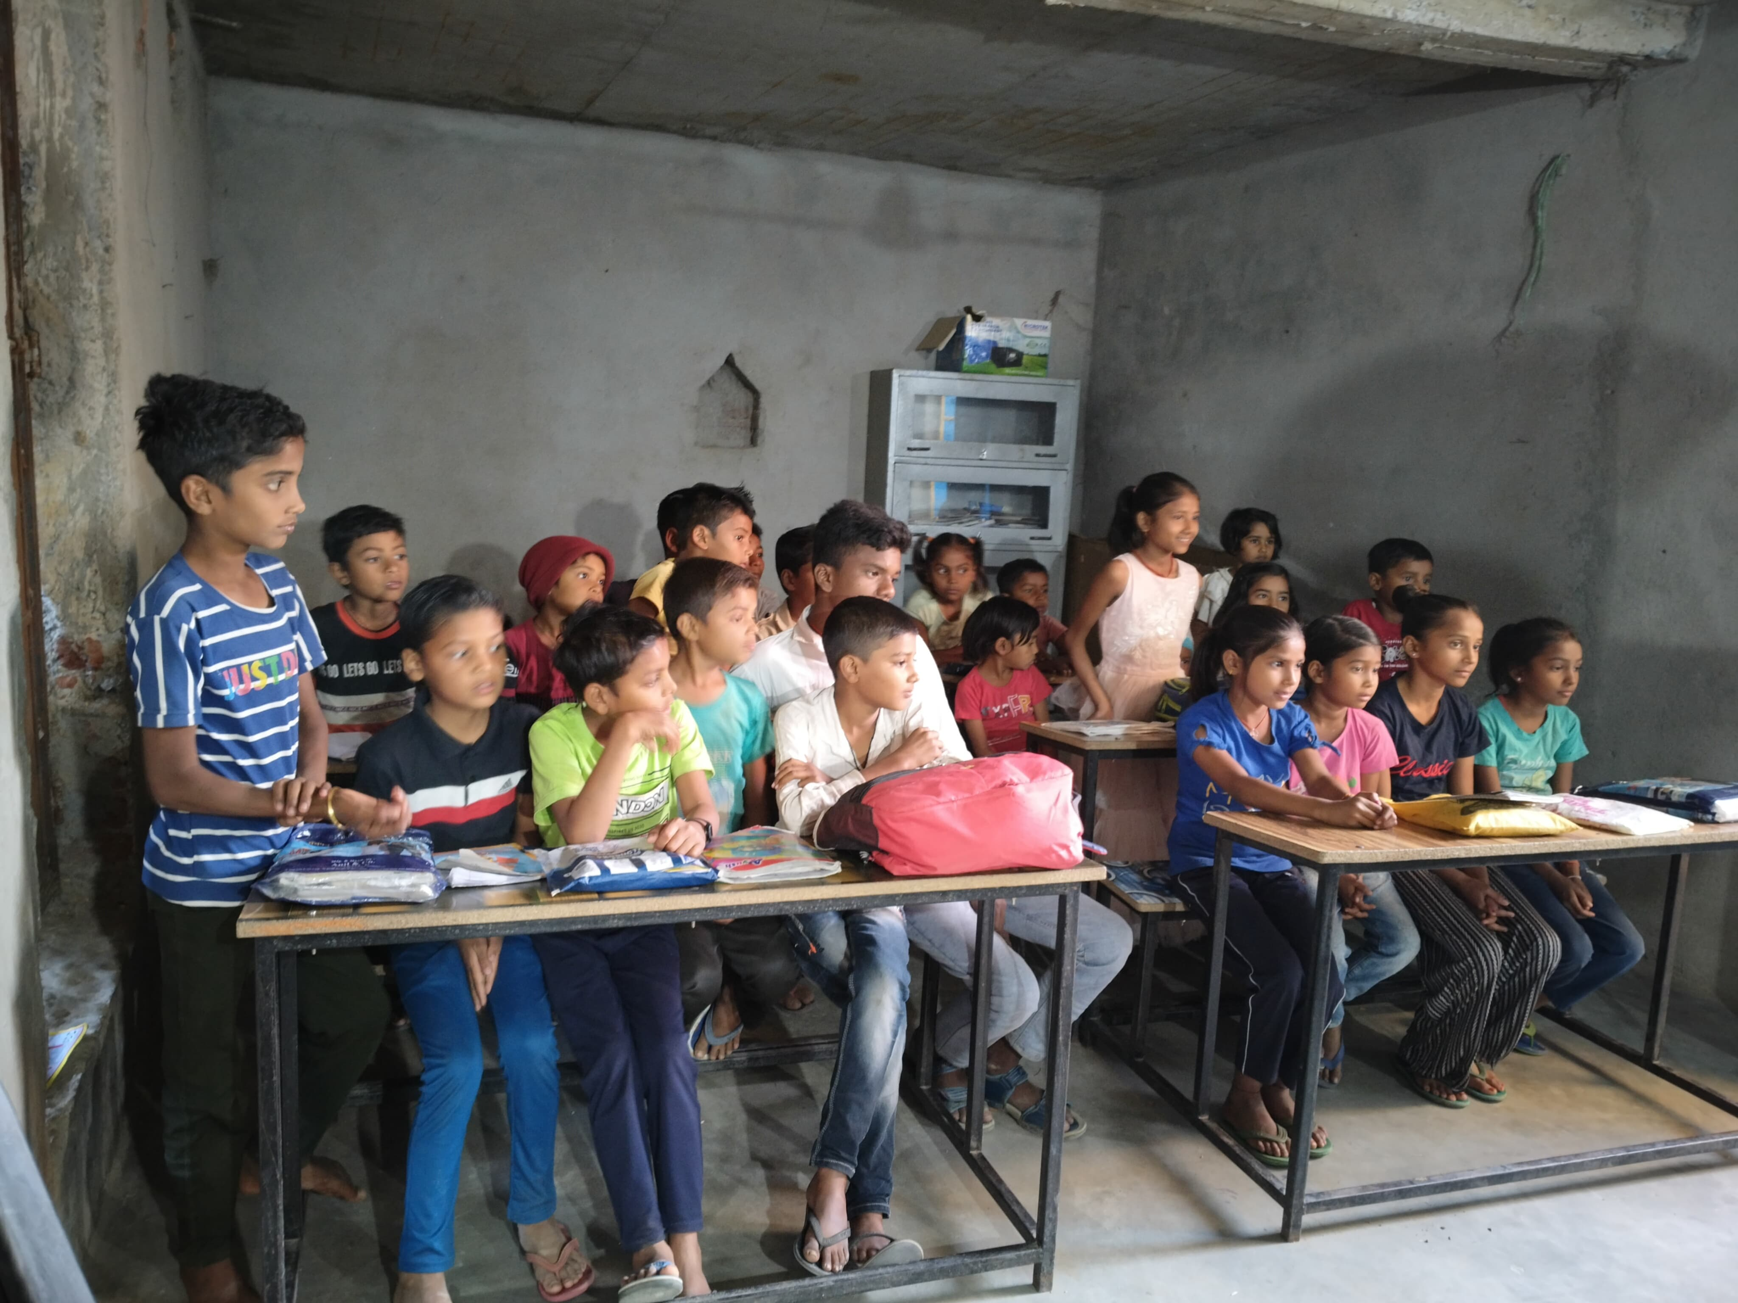
Jharkhand learning centres
Piprahi village learning centre
Outside Sirohi Khurd learning centre
Rabda village learning centre

Slide 26
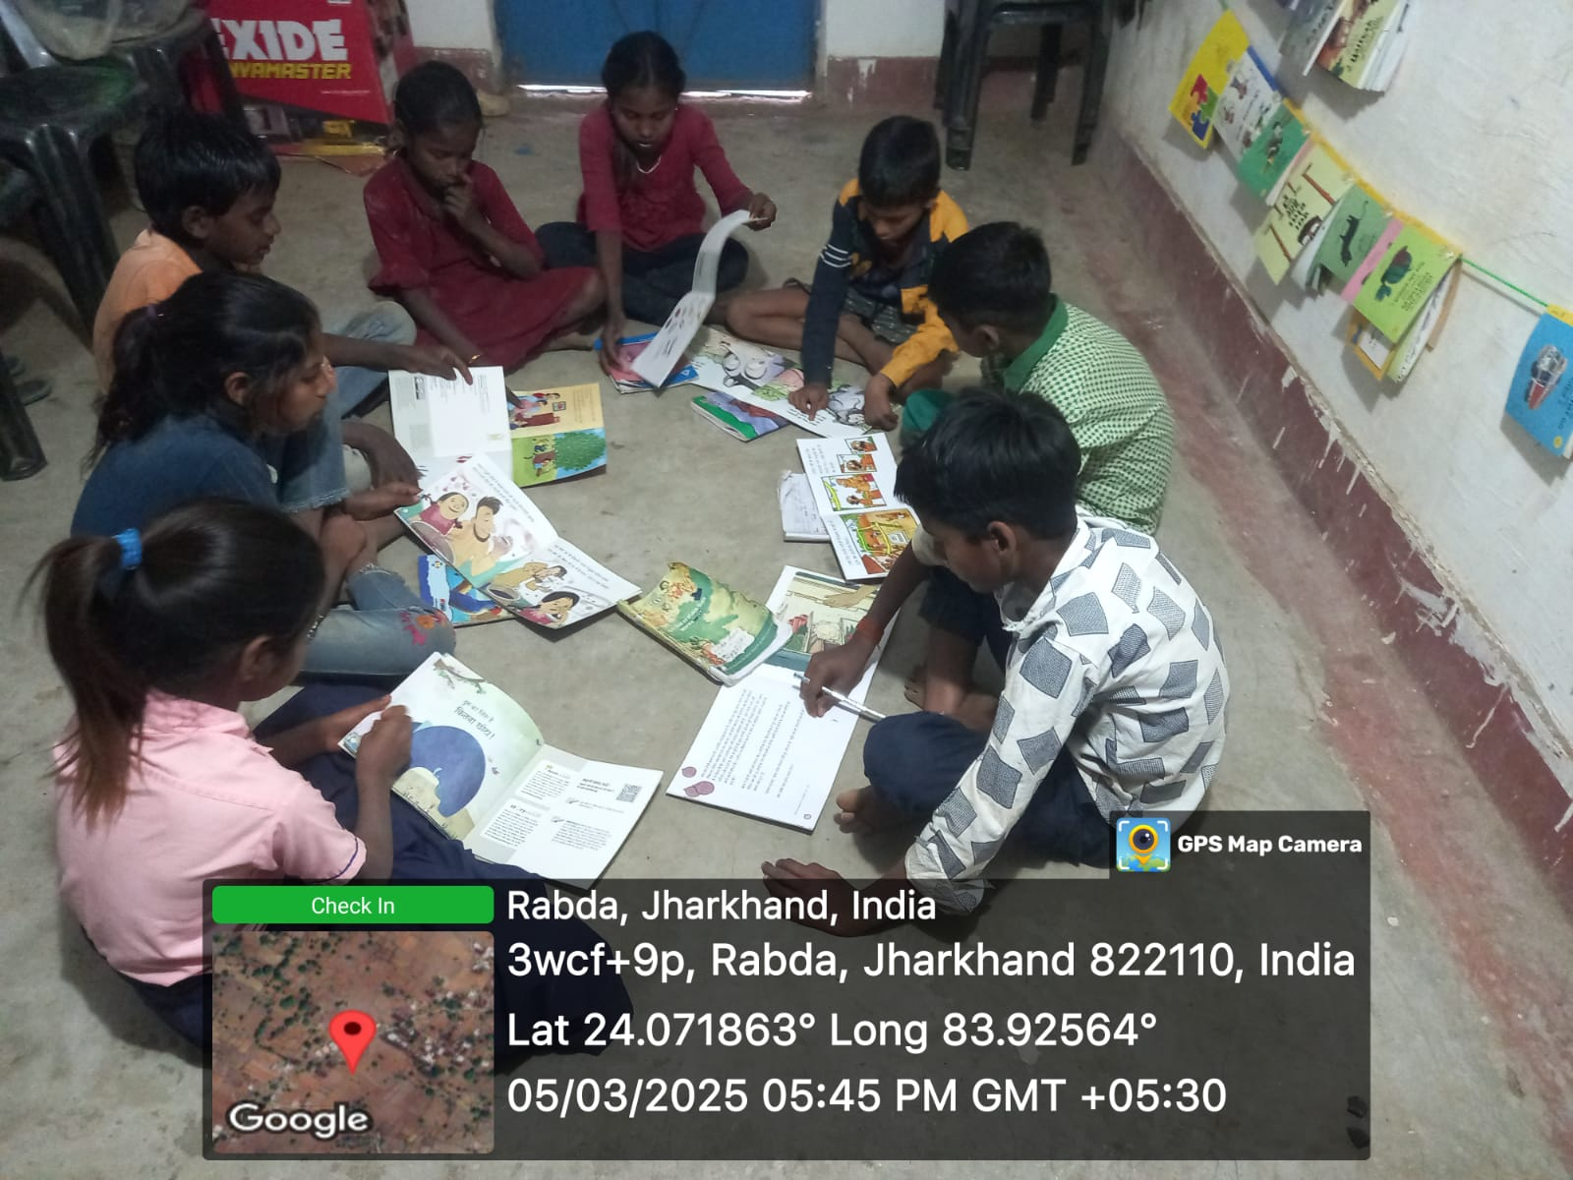
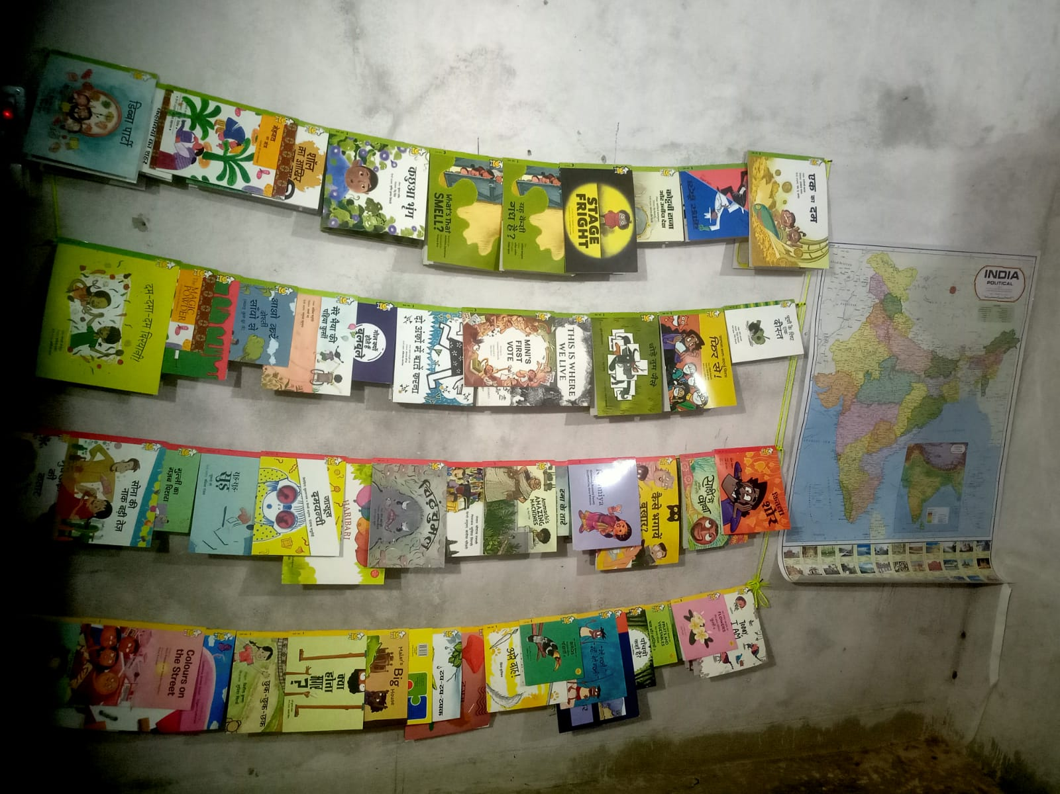
Jharkhand learning centres
Reading books
Outdoor activity
Wall library

Slide 27
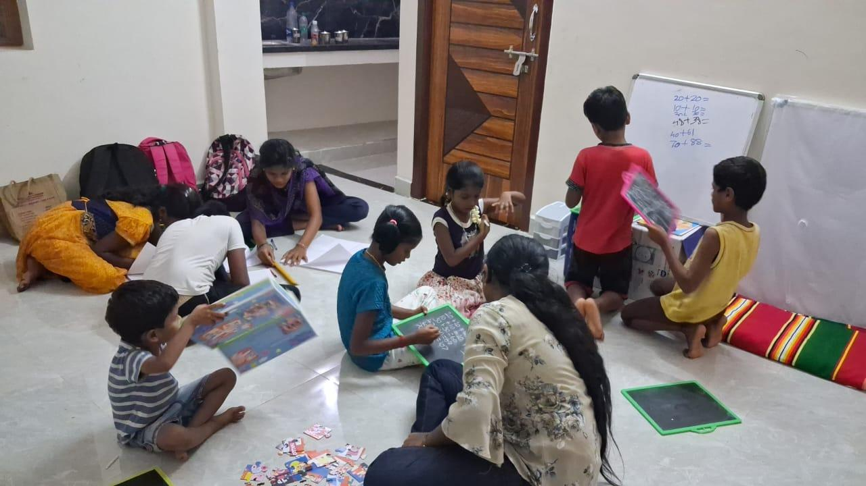
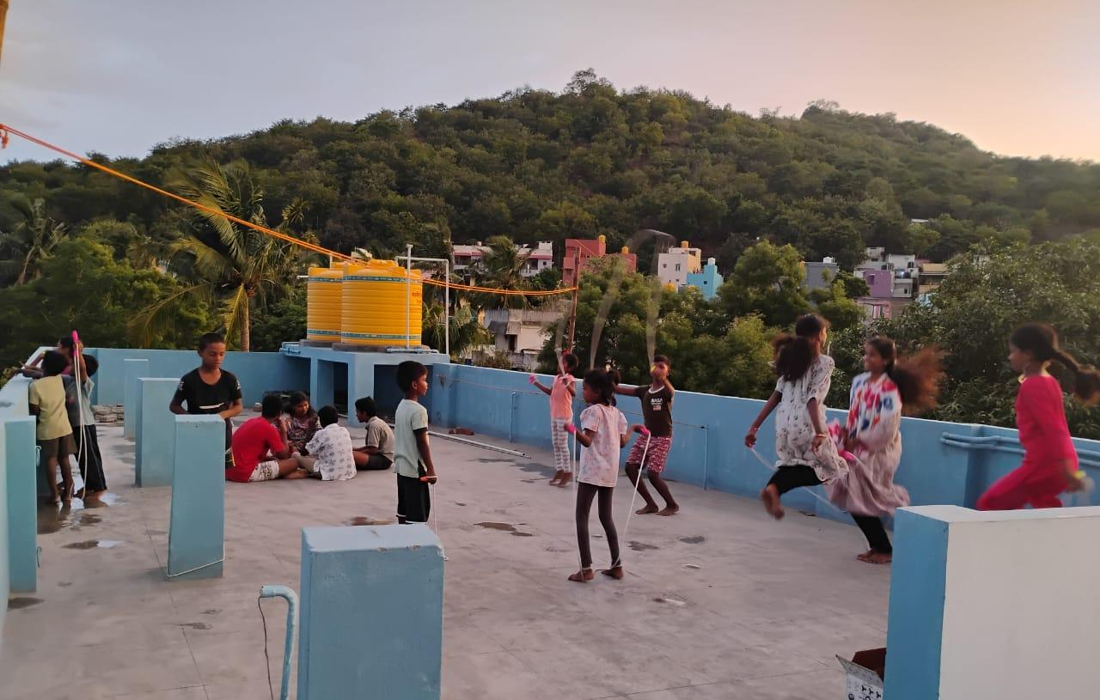
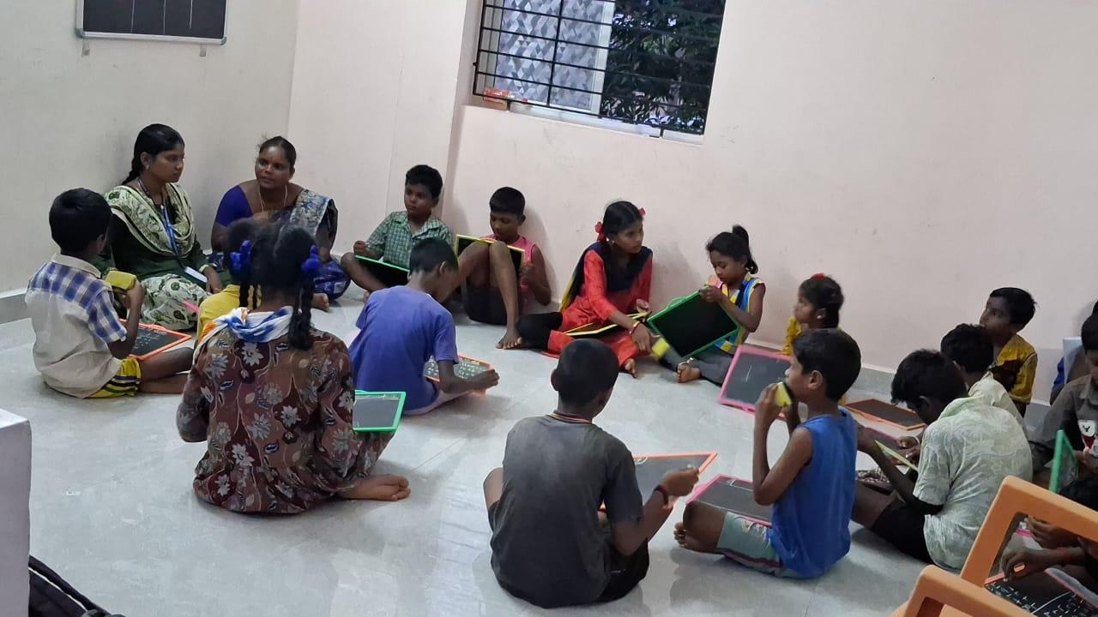
Chennai (Thirusulam) learning centre
Indoor activity
On the terrace
A class with centre facilitators

Slide 28
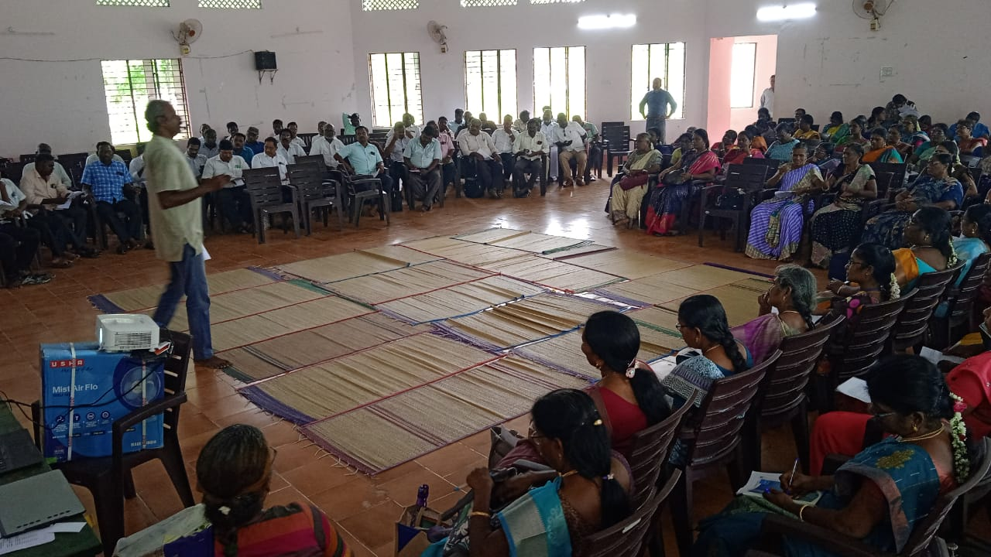
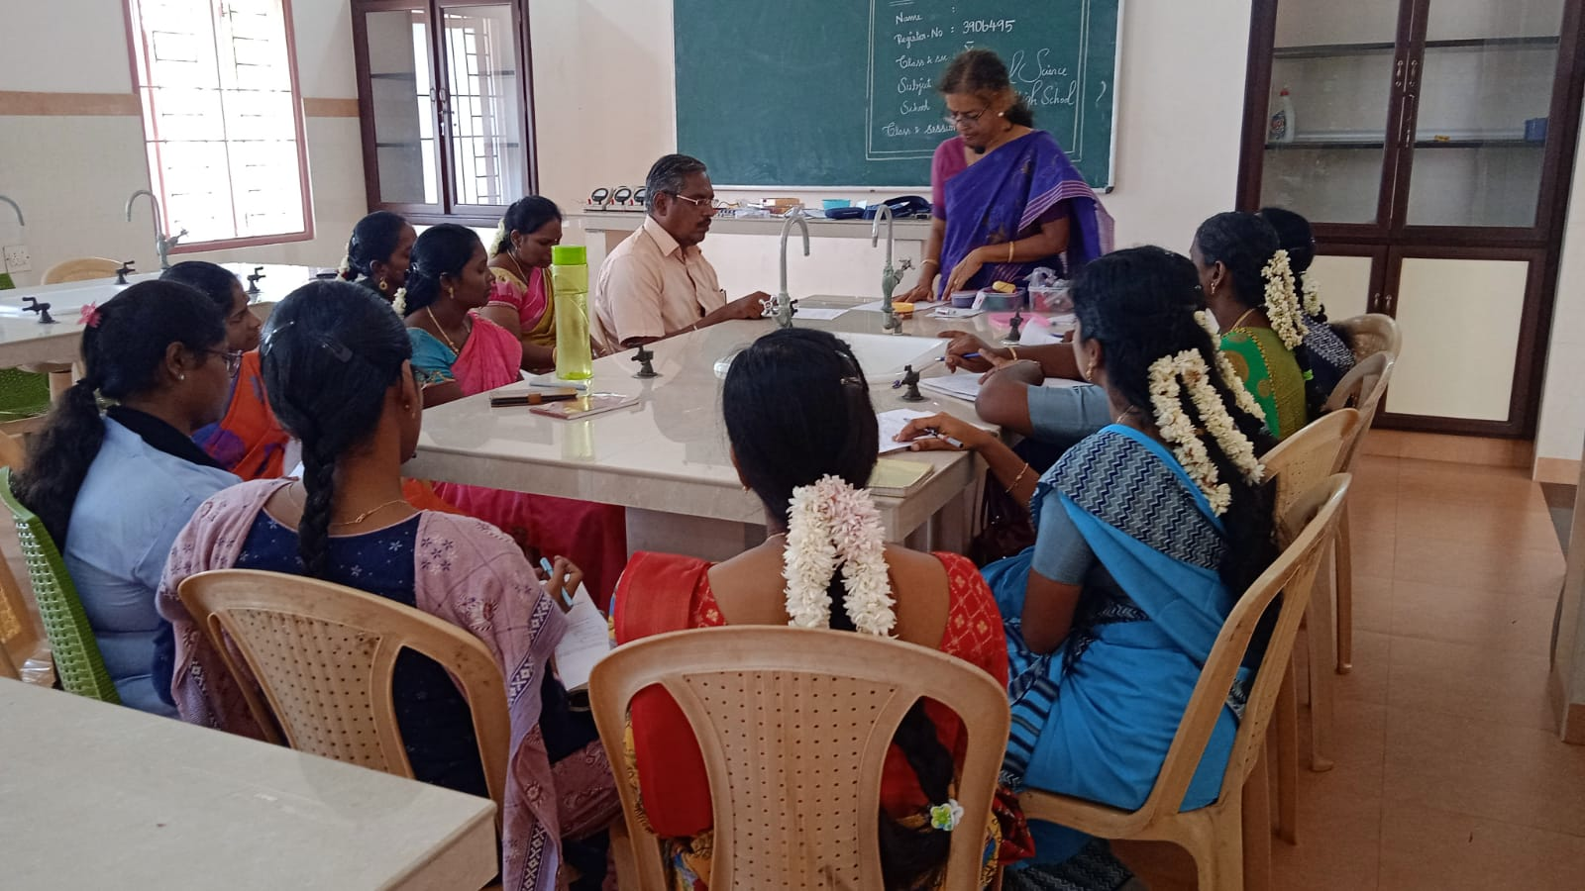
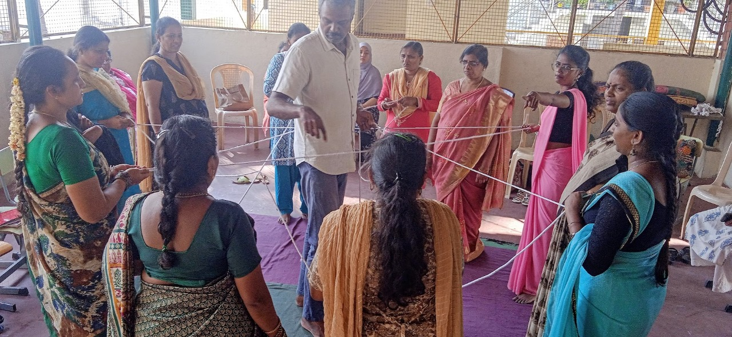
Teacher empowerment program
Workshop with govt school teachers in Chidambaram, Tamil Nadu
Science workshop with
govt school teachers in Chikkaballapur, Karnataka
Integrating primary mathematics with physical movements, with teachers at Bambino school, Bangalore

Slide 29
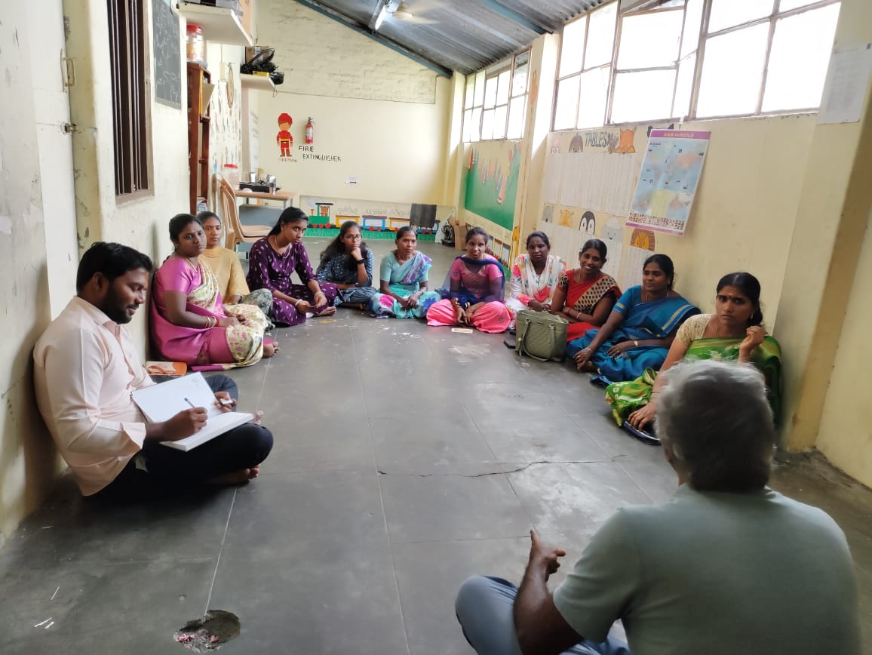
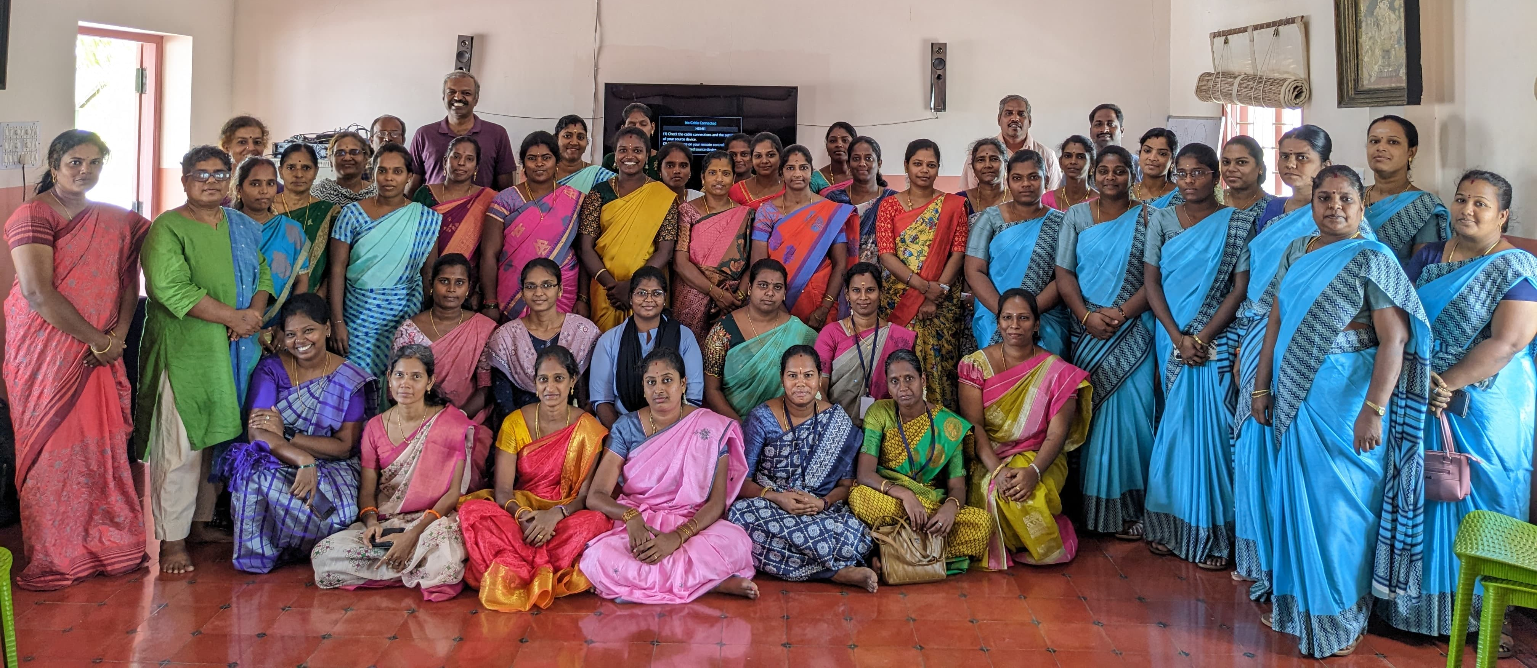
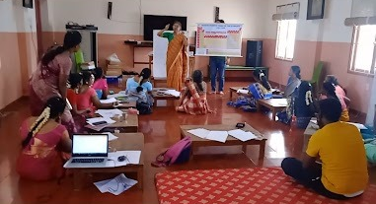
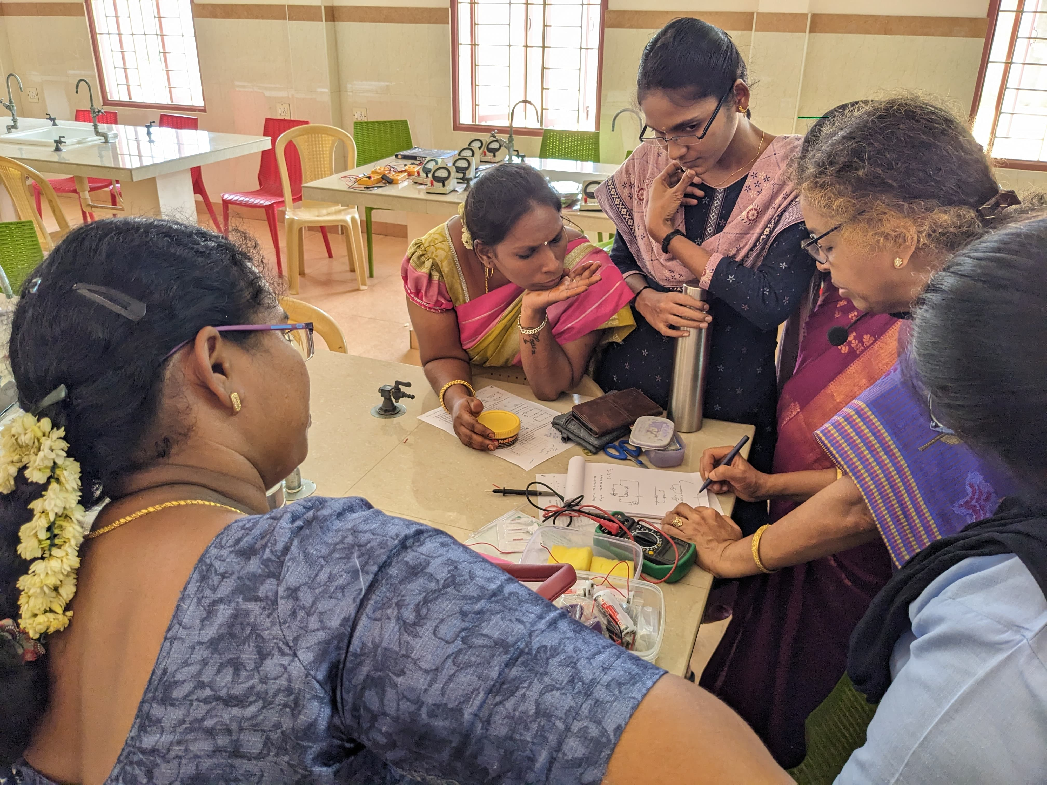
Teacher empowerment program
Pedagogy workshop with teachers in Madurai, Tamil Nadu
Teachers of Gandhiji and other schools in Pondicherry participating in mathematics & science workshops
Teachers discussing a science experiment

Slide 30
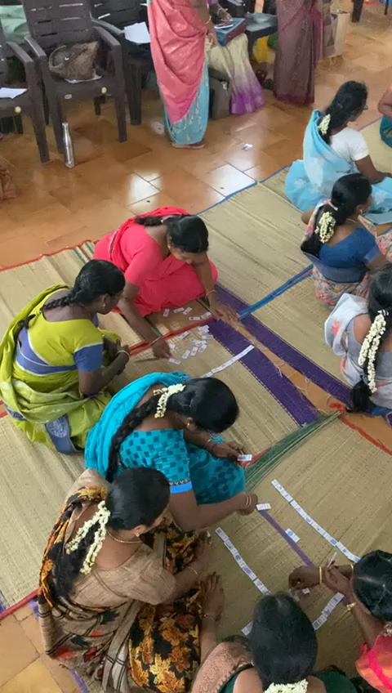
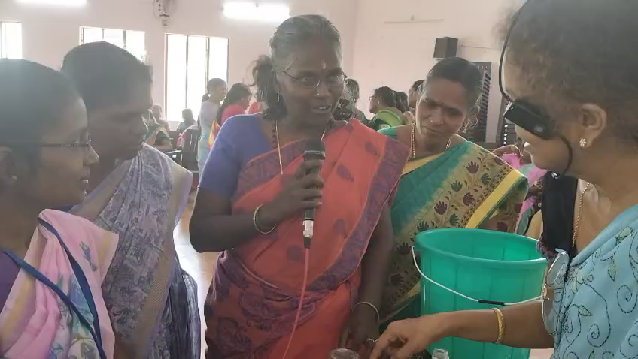
Teacher empowerment program
Govt school teachers sharing ideas over a science experiment (video)
Teachers playing dominoes game integrated with learning mathematics (video)

Slide 31
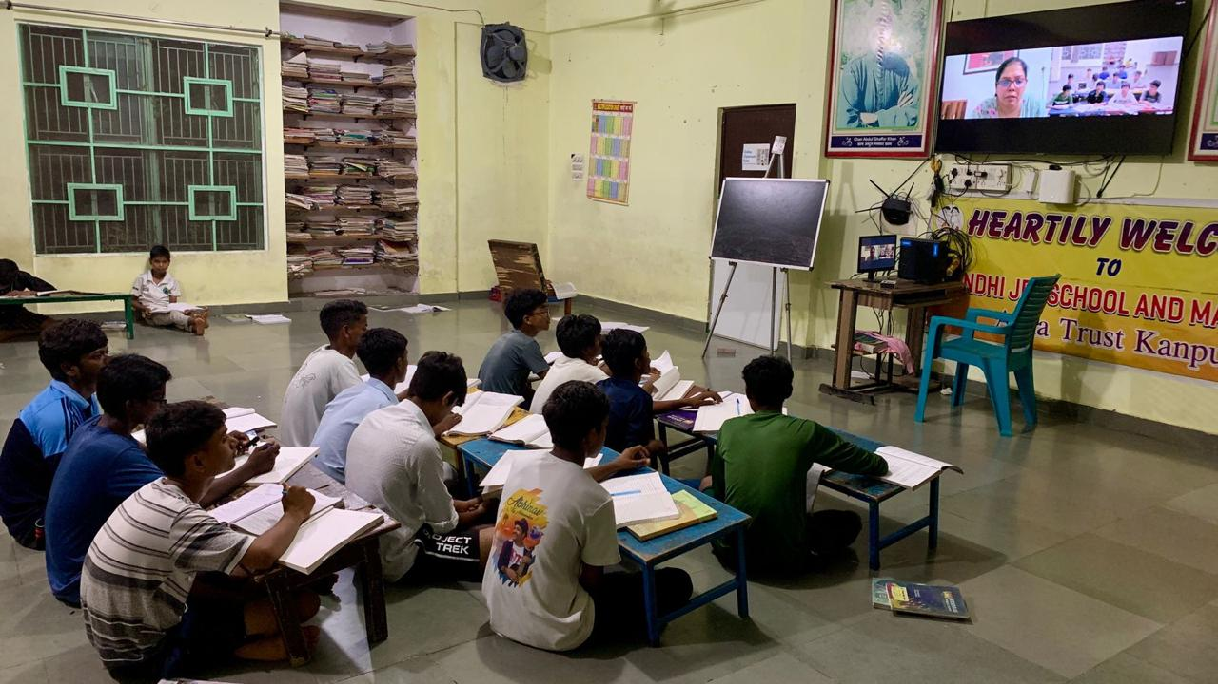
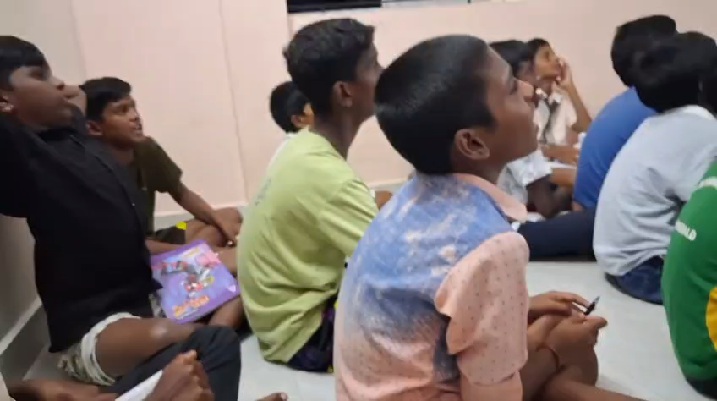
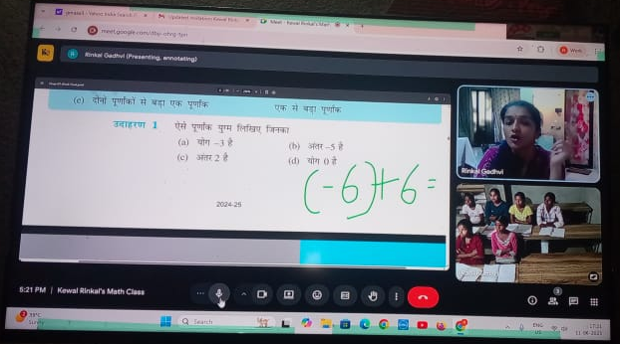
Online classes
Kids in a mathematics class at Chennai centre (video)
Kids at Apna Ghar, Kanpur, in a class on English and communication
Kids at a Jharkhand centre, in a mathematics class

Slide 32
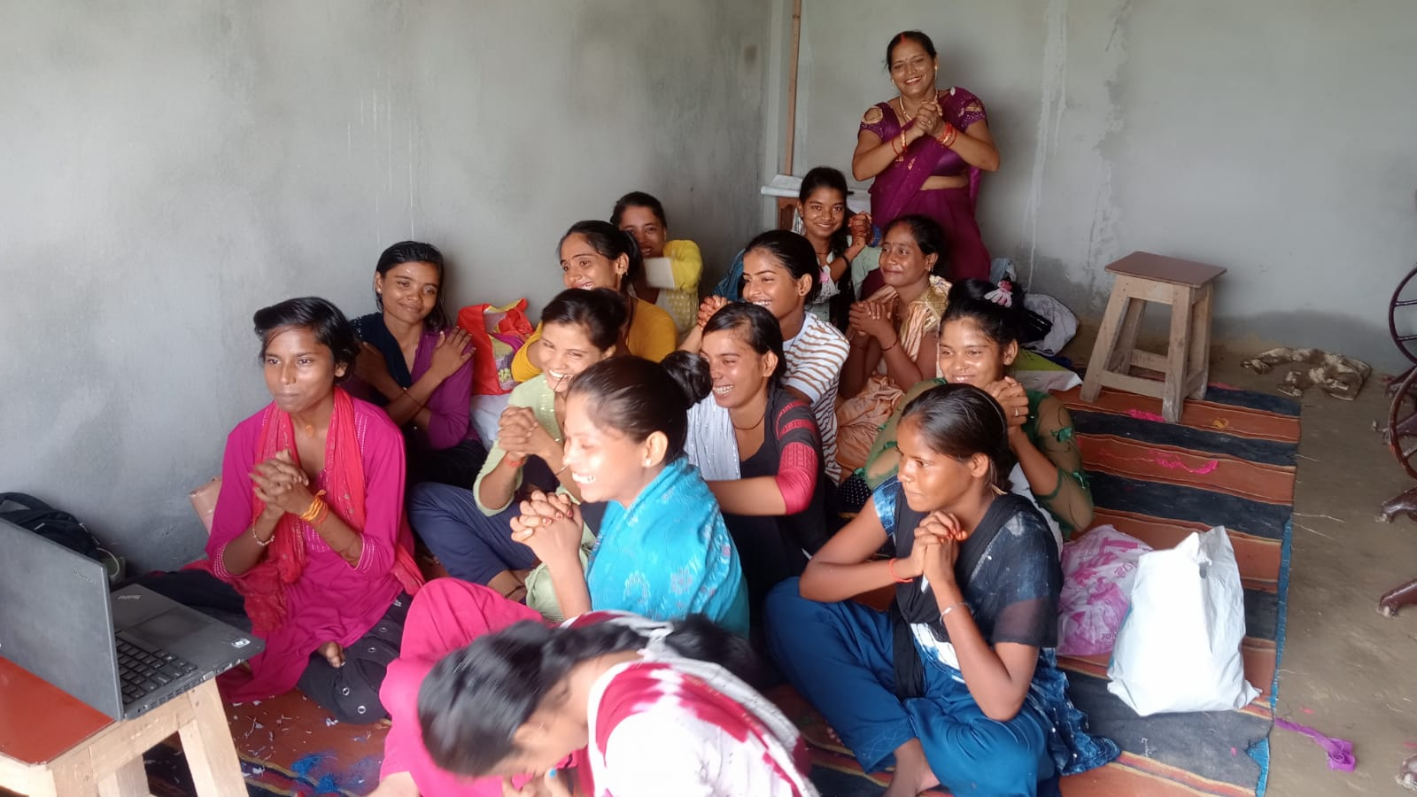
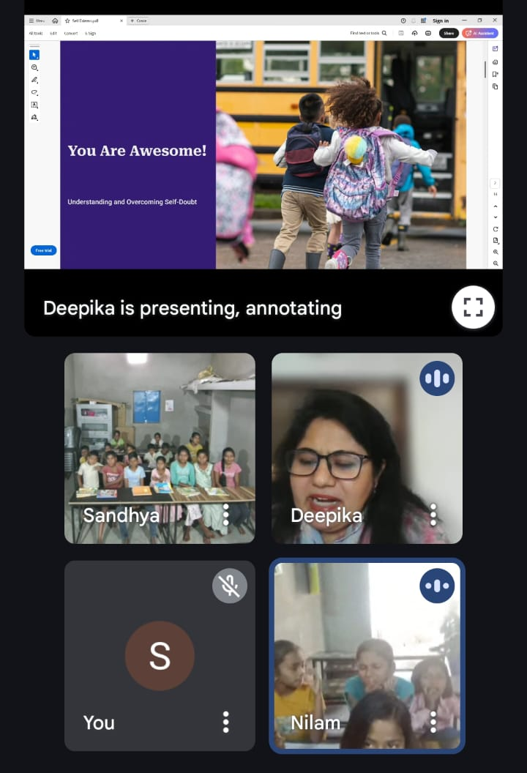
Online classes – empowering young minds
Girls in rural Varanasi participating in a series of sessions on women’s rights, child’s rights, gender issues, safety, health, menstruation, mental health, and opportunities for further education, scholarships, and employment
Deepika discussing mental health and well-being with children in two Jharkhand villages

Slide 33
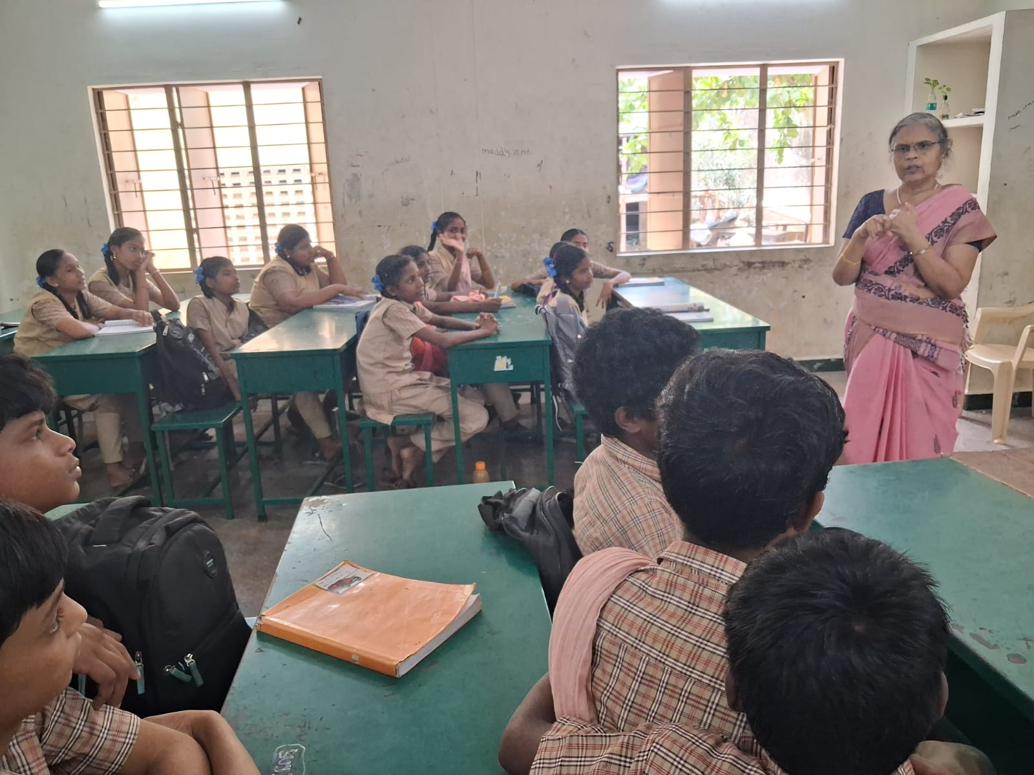
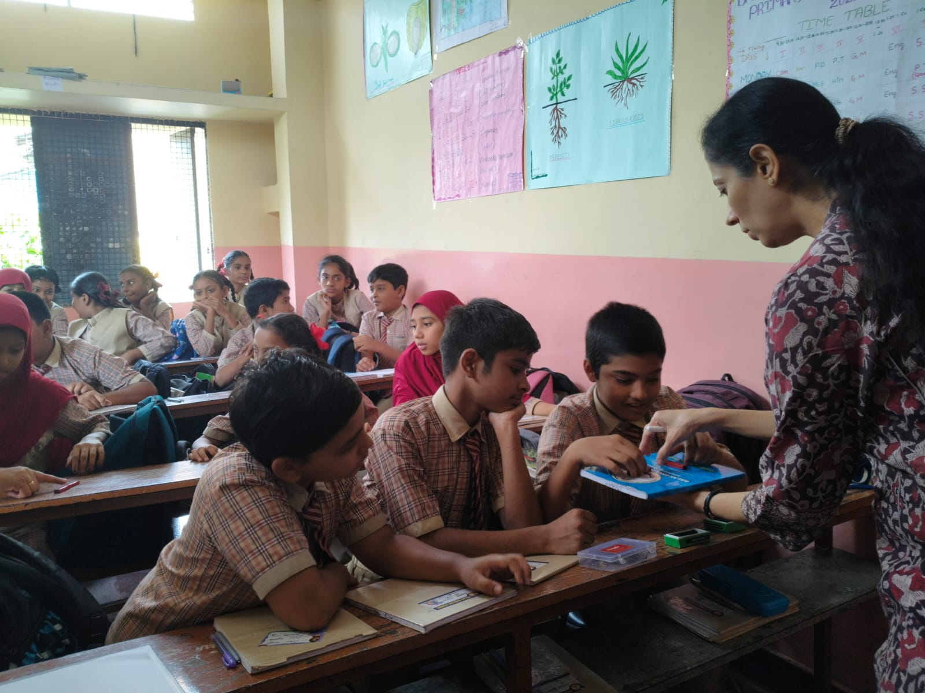
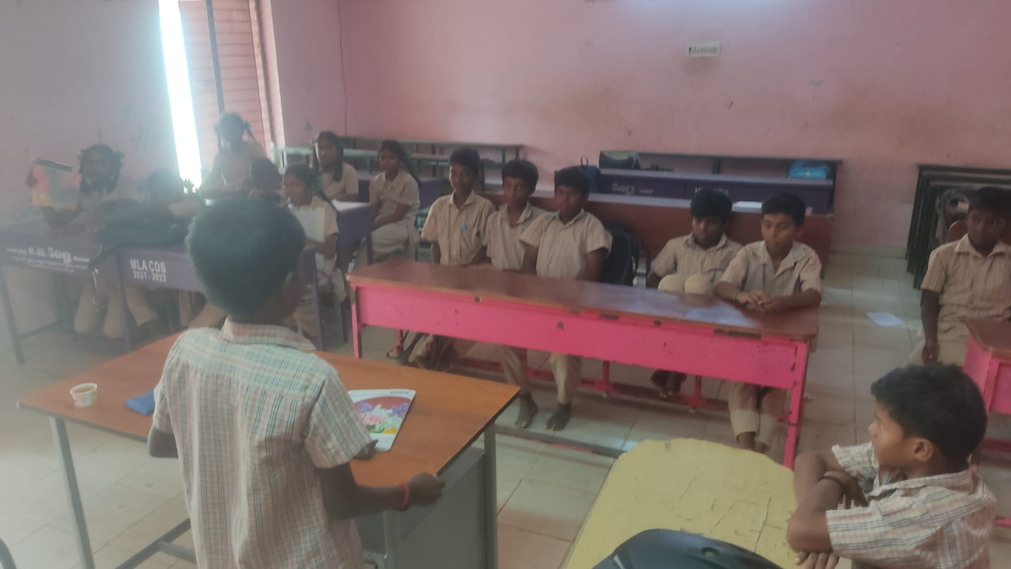
In-person classes
Akhila taking mathematics class at govt school, Meenambakkam, Chennai
Rajashree taking science class at Balak school, Bangalore
A child sharing his personal life story at a mathematics class at GTR govt school, Tiruvannamalai, facilitated by Senthil

Slide 34
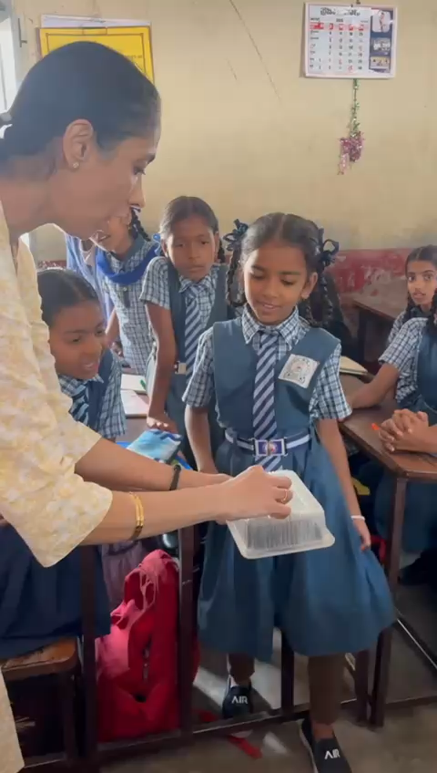
In-person classes
Rajashree demonstrating magnets to students as part of science class at Anand Society school, Bangalore (video)

Slide 35
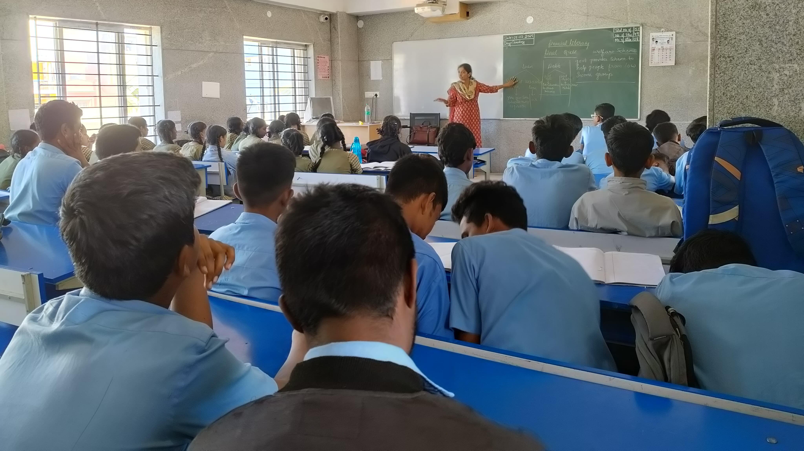
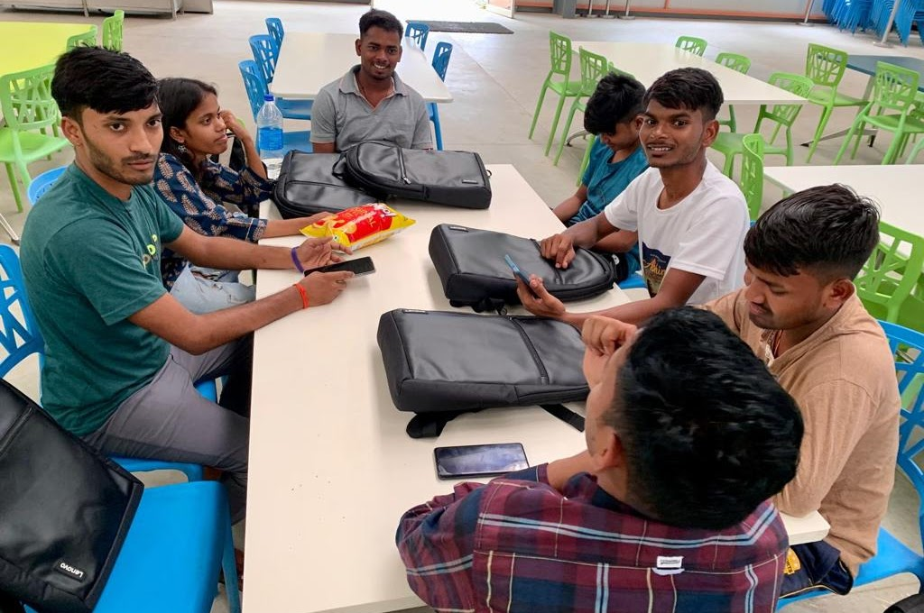
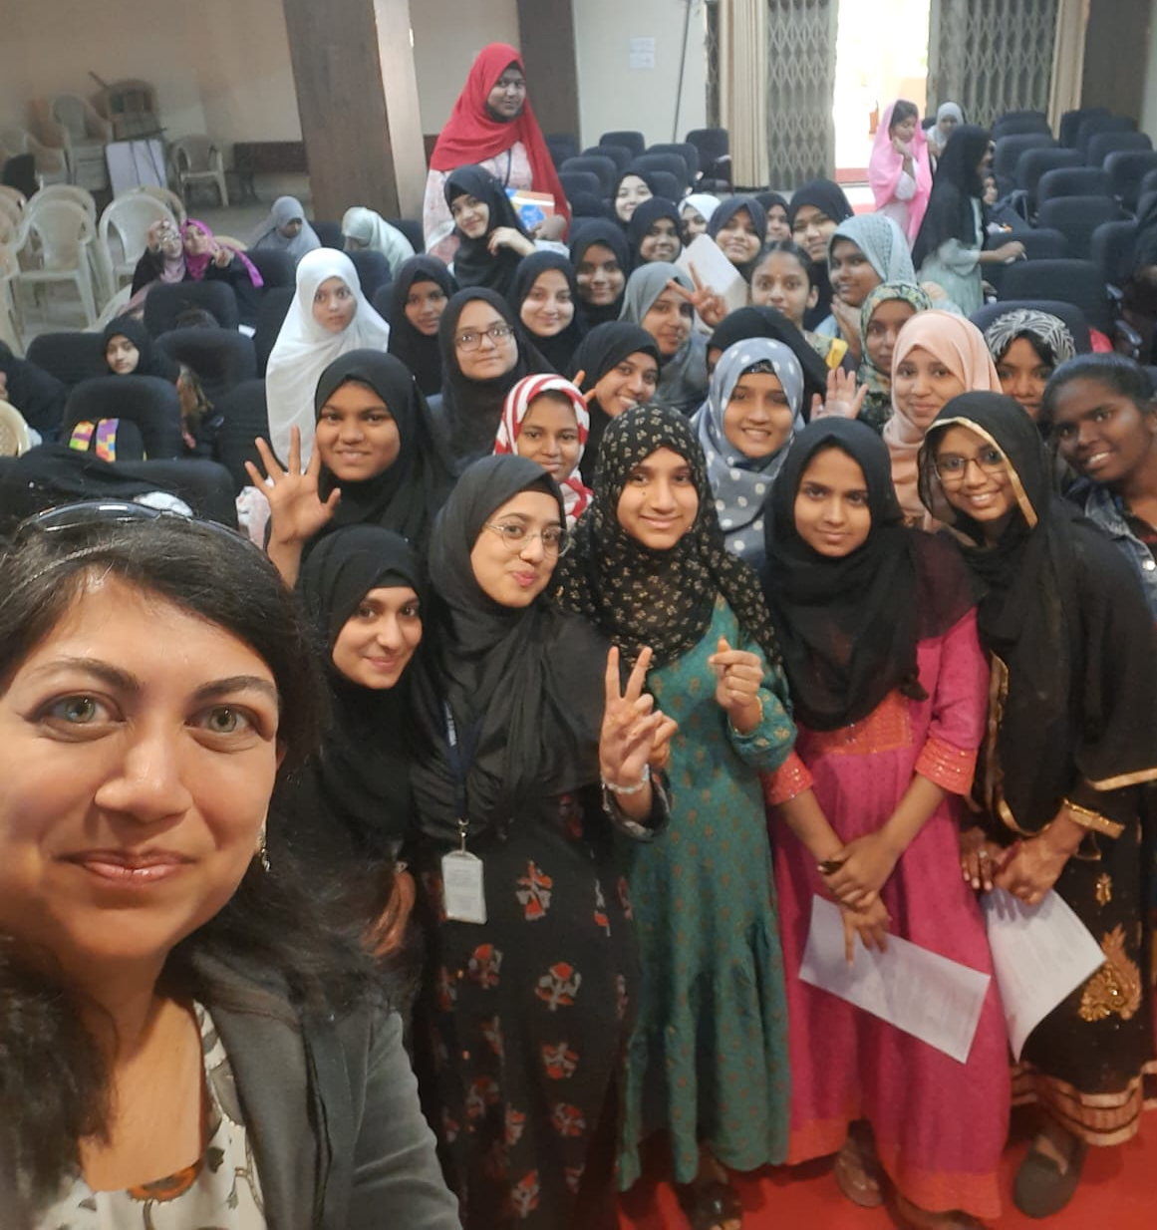
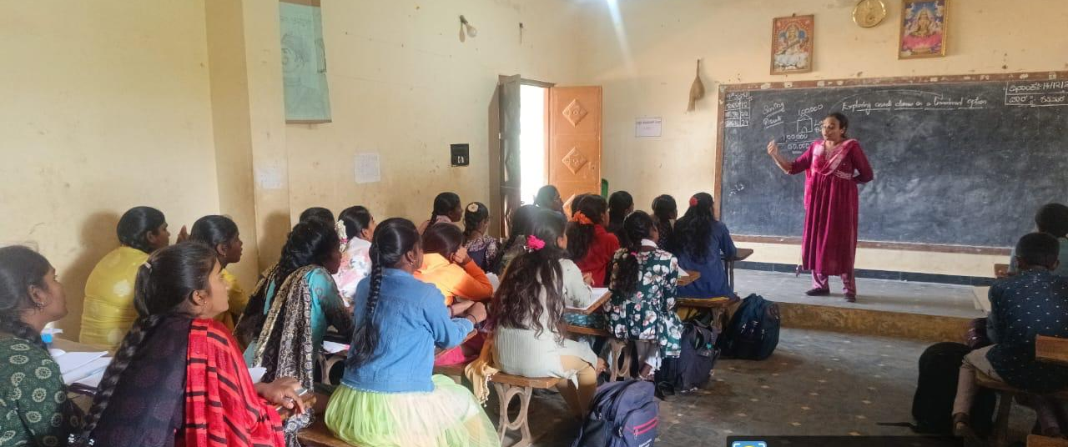


Other activities
Financial literacy sessions and bank visit for students at govt schools in Bangalore, Chikkaballapur, Hyderabad
Children from Apna Ghar (originally from UP, Bihar, Chhatisgarh) pursuing undergraduate program at Azim Premji University, Bangalore

Slide 36




Other activities
Children from Vanavil, Nagapattinam (Tamil Nadu), on an excursion to Bangalore, hosted by CLE team
Children at Yellow Bag centre in Madurai participating in a 2-week summer camp conducted by Ananth

Slide 37
CLE Team

Slide 38

CLE team: Learning centre facilitators
Facilitators of IDBI-CLE centre in Thirusulam, Chennai (Thenmozhi and Sathya) with children from the community
Facilitators of Chaitanya-CLE centres in Jharkhand (Beauty, Khushbu, Neelam, Pramila, Rani, Rita, Sandhya, Seema, Shanti) with CLE members (Abhishek, Leela, Sangita)

Slide 39

CLE team: Online teachers
Akhila, Amit, Ananth, Asha, Ashwini Priya, Bhama, Bharathi, Bindu, Divya, Geehan, Harshit, Karman, Keerthana, Kirti, Loga, Medha, Mitsu, Neelanjali, Parvathy, Pavana, Payal, Pradnyesh, Prity, Priyada, Rachana, Rajashree, Rashmi, Reshmi, Rinkal, Saritha, Senthil, Shalini, Shraddha, Shriya, Srija, Shruthi, Subathra, Surekha, Thenmozhi, Vignesh, Vishal

Slide 40

CLE team: Mentors for teacher empowerment program
Ramesh, Senthil, Bhama, Thenmozhi, Sreepathi, Sharad

Slide 41



CLE team: Program managers and trustees
Program managers:
Abhishek, Imtiaz, Kavitha, Leela, Sangita, Shalini
Trustees:
Adithya, Bhama, Rahul, Ramesh, Ritash, Santhakumar, Senthil, Thenmozhi

Slide 42
How you can be part of our mission

Slide 43
How you can be part of our mission
Teach a subject or life-skill (online)
Conduct awareness sessions or workshops on an important theme (online or in-person)
Conduct a summer camp (in-person)
Contribute to developing curriculum and learning materials
Help us use technology to scale
Help us find opportunities to start new learning centres, teacher empowerment workshops, and online classes
Donate

Slide 44

Thank You!
Visit us: www.cletrust.org
Contact us:
info@cletrust.org
leela@cletrust.org

